Slide 1
Expectations of Professionalism for Johns Hopkins Hospital
Student’s Name
Course Name
Date

Slide 2

Introduction of John Hopkins Hospital
The Johns Hopkins Hospital (JHH) is one of the leading hospitals and medical institutions
JHH is a teaching hospital and biomedical research facility, founded in the last quarter of the 19th century by Johns Hopkins
JHH’s major focus is patients, through advanced patient care and continuous quality improvement
This assignment is based on an observation that took place on 14th august 2020 at JHH facility
I carried out the observation as a Clinical Elective at the JHH
Notes:
The Johns Hopkins Hospital is among the leading hospitals and medical institutions in the United States and abroad. The hospital was founded in the last quarter of the 19th century by John Hopkins. Since its inception, the JHH has maintained its major focus in providing advanced patient care and continuous quality improvement. To complete this assignment, I accurately completed a thorough observation of the core aspects of professionalism within the organization. My role during the observation was that of clinical elective at the John Hopkins Hospital.

Slide 3
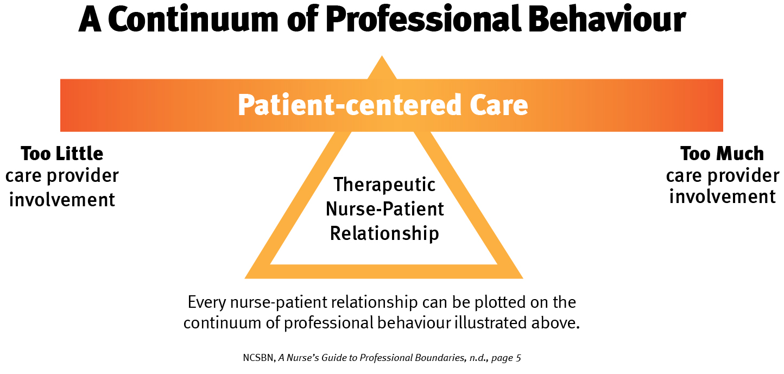
Professional Appearance Expectations
Healthcare professionals at JHH are required to:
Be in professional attire
Follow the prescribed dress code
Appear neat, maintain their hair back and off their shoulders
Maintain professionalism by abiding by the JHH dressing code and other professional etiquettes
Notes:
The Registered Nurses are highly reputable employees at the John Hopkins Hospital, and hence they ought to maintain a high degree of professionalism. As per the organization rules, the RNs are expected to be professional attires all the time. In my observation at JHH, nurses should be easily identified by uniform pantsuits, scrubs, and a variety of other clothing on the job. Clothes should not restrict movement when taking care of a patient. It is recommendable for nurses to wear closed-toe and non-athletic shoes, which are impermeable to liquids and should not produce excessive noise. Every registered nurse must bring his or her own white coat and stethoscope. Nurses must keep their hair neat while maintaining the hair back and off their shoulders. To maintain professionalism, it is mandatory for healthcare professionals to abide by the JHH’s recommended dressing code, observe effective communication, and other professional etiquettes.

Slide 4

Professional Behavior Expectations
RNs on clinical rotations must have proficient spoken and written English language skills
RNs must effectively communicate with patients concerning care plans, accurately record and document patient’s data with increased privacy
New nurses should address issues by communicating with supervising physicians and multidisciplinary team (Yoder, 2017)
Nurses are not expected to come late to work or coming back late from breaks more than two times per month
Nurses should keep off their phones or other communication gadgets when in their call of duty
Notes:
RNs are expected to observe professional conduct in all clinical settings. Nurses must depict highly proficient and written English language skills, a core tool in healthcare service provision since it paves the way for offering patient-centered care. Nurses are expected to abide by the ethical principle of patient’s autonomy through effective communication with patients concerning care plans. More importantly, nurses must demonstrate reputable skills in recording and documenting patient’s information for quick reference and increased privacy (Yoder, 2017). New nurses should address issues or complaints by communicating with supervising physicians and a multidisciplinary team, seeking guidance where possible, and demonstrating increased professionalism and responsibility. Tardiness is highly condemned at the JHH, and hence healthcare professionals are not expected to report late or come back late from breaks. Increased tardiness may lead to the termination of an RN’s job after repeated caution for the need for improvement. The management highly embraces the fact that the organization’s goals come first in every clinical setting. For that reason, nurses are required to keep their phones away when in their call of duty so as to maintain focus and professionalism.

Slide 5

Professional Fit
Every potential candidate for JHH must ask themselves:
Do I have the relevant skills to meet the organizational goals?
What are the professional appearance expectations for the Johns Hopkins Hospital? (Yoder, 2017)
What are the most acceptable professional behaviors at Johns Hopkins Hospital?
How best should I address issues or complaints when in the call of duty?
Notes:
Professional fit questions are quite essential in that they help an employee to meet and maintain the organization’s expectations. At JHH, RNs should question the relevance of their skills to define whether they stand a chance to meet the set organizational goals and expectations (Yoder, 2017). It is also important for registered nurses to question their dressing code and make sure it is in line with the professional appearance behaviors at the facility. The nursing profession is always open to increased risks and challenges, and these are likely to affect the quality of care for patients. Herein, it is paramount for nurses to question their degree of competence or problem-solving skills in the context of work. Overall, every potential nurse should remain in the frontline to carry out self-evaluation for improved clinical practices that would best meet the goals of an organization.

Slide 6
References
Yoder, L. (2017). Professionalism in nursing. Medsurg Nursing, 26(5), 293-295.

